Slide 1
Modelling an Electronic component
OLIVER CANVIN TYLER ELLWOOD NIKKISSJA LEO ALEXANDER LUDFORD-KIDD

Slide 2
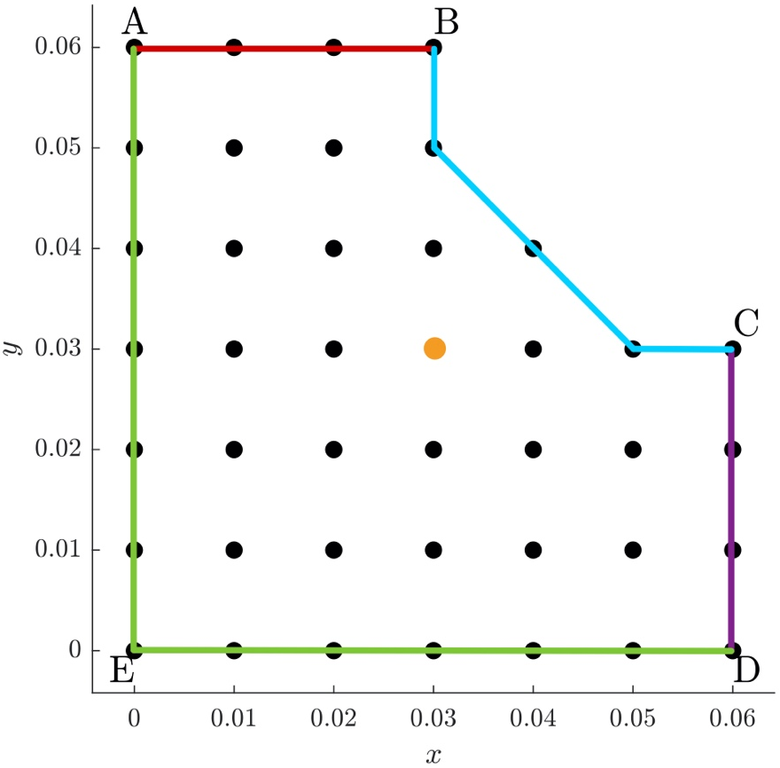
Electronic component schematic

Slide 3
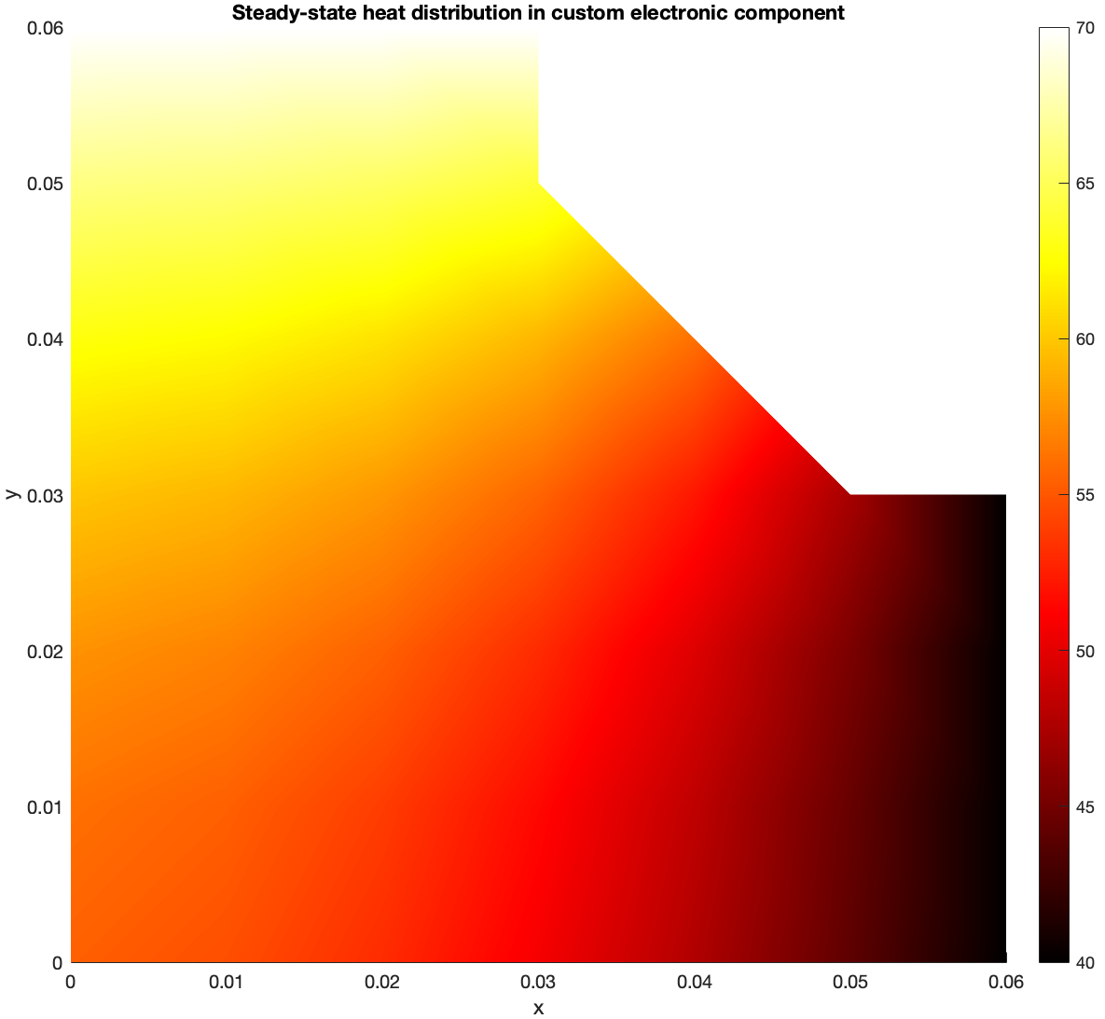
Heat Distribution in electronic component

Slide 4
ambient temperature exposure

Slide 5
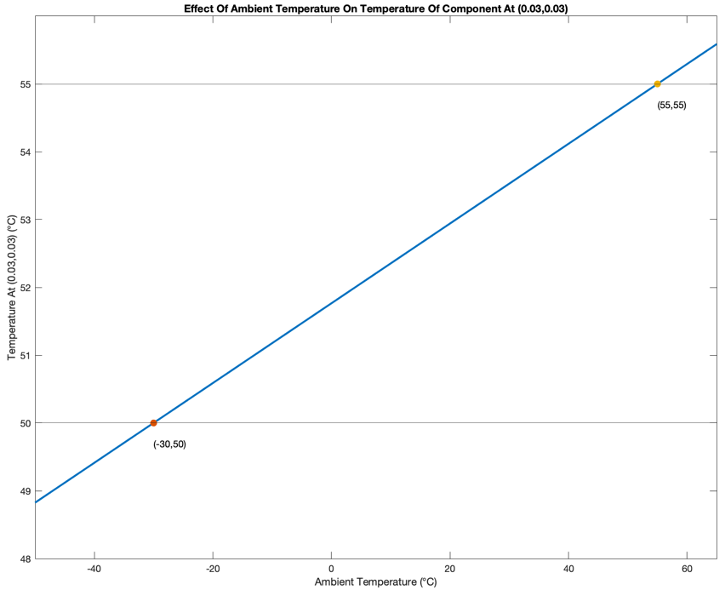
Heat Distribution in electronic component

Slide 6
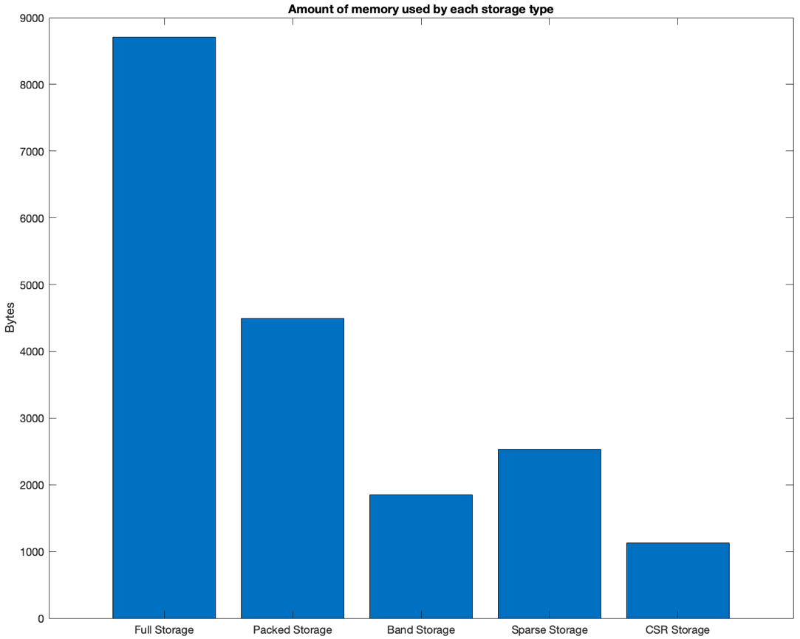
MEMORY USAGE

Slide 7
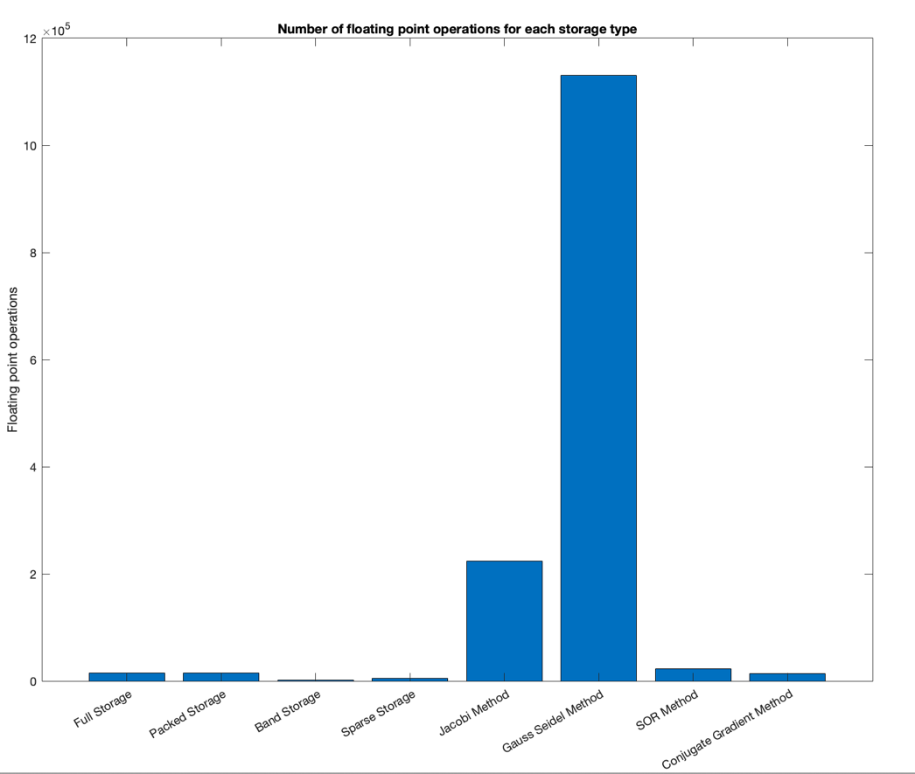
FLOATING-POINT OPERATIONS

Slide 8
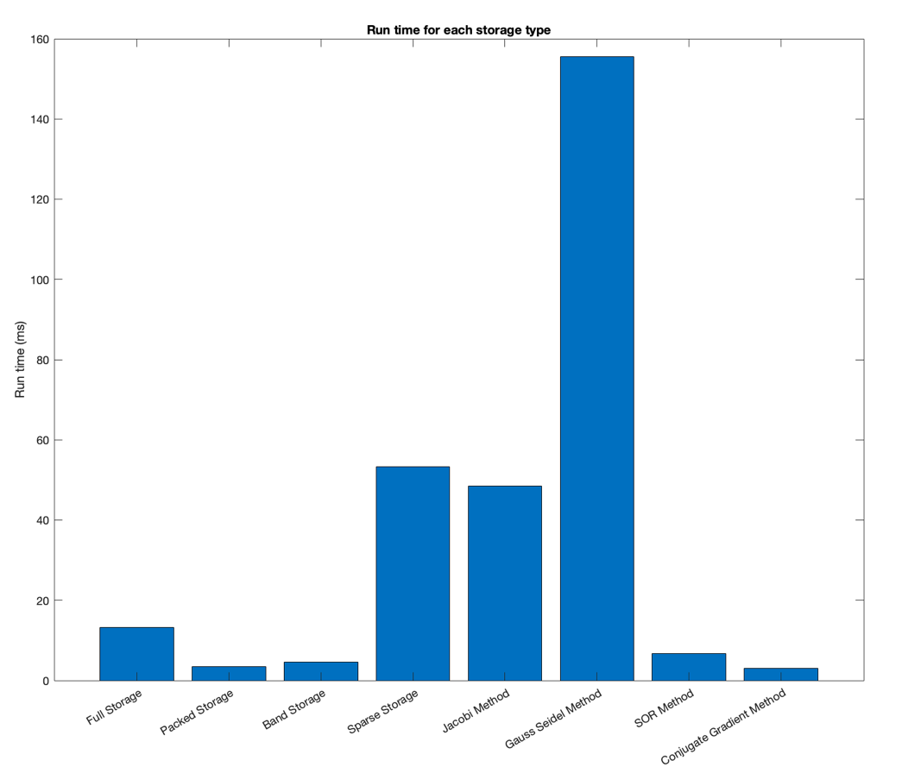
RUN TIME

Slide 9
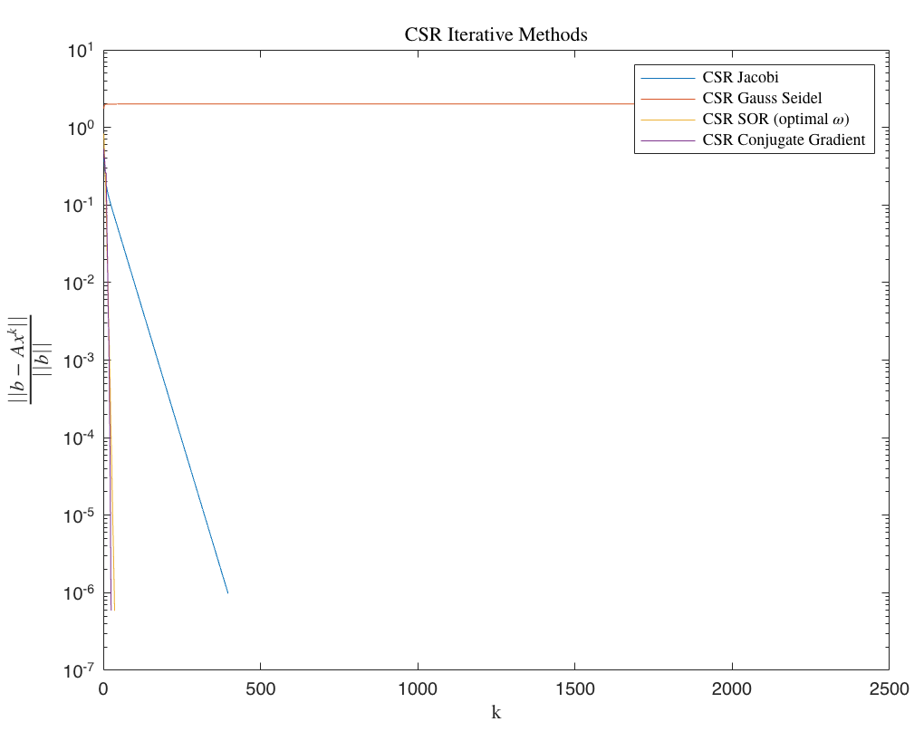
Residual norms against iterations

Slide 10
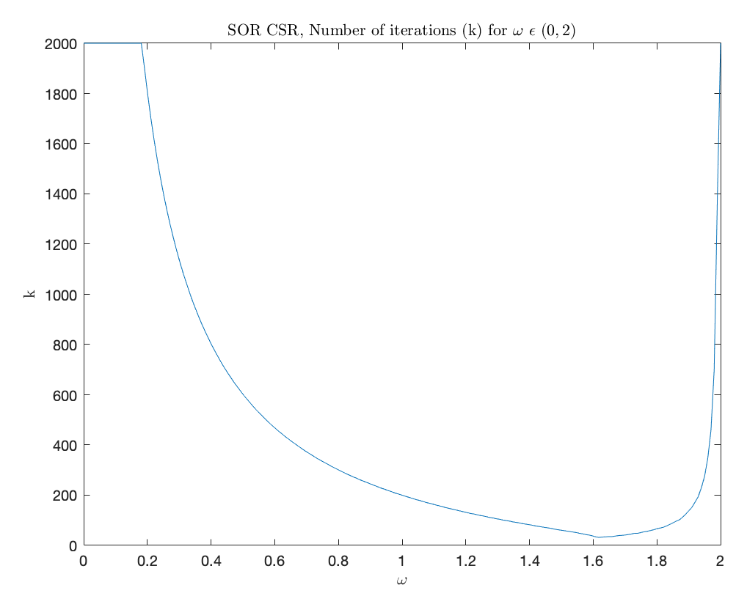
omega against number of iterations required to converge to tolerance

Slide 11
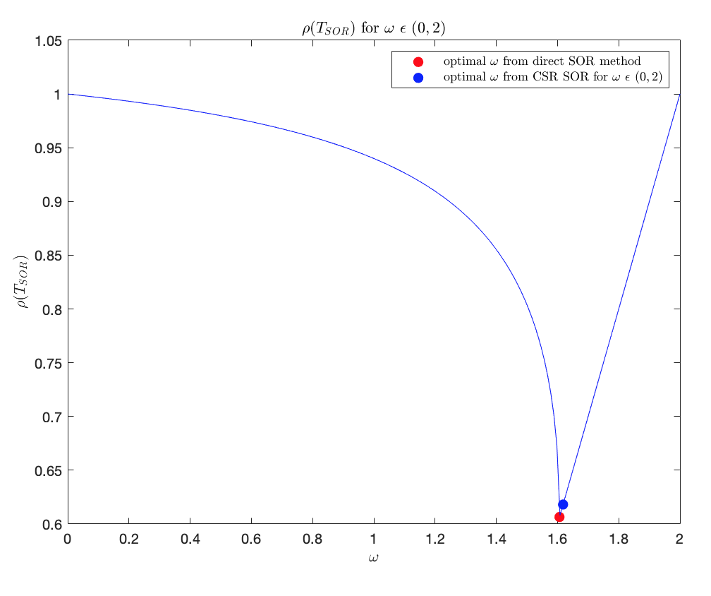
NOT SURE WHAT THIS TITLE SHOULD BE

Slide 12
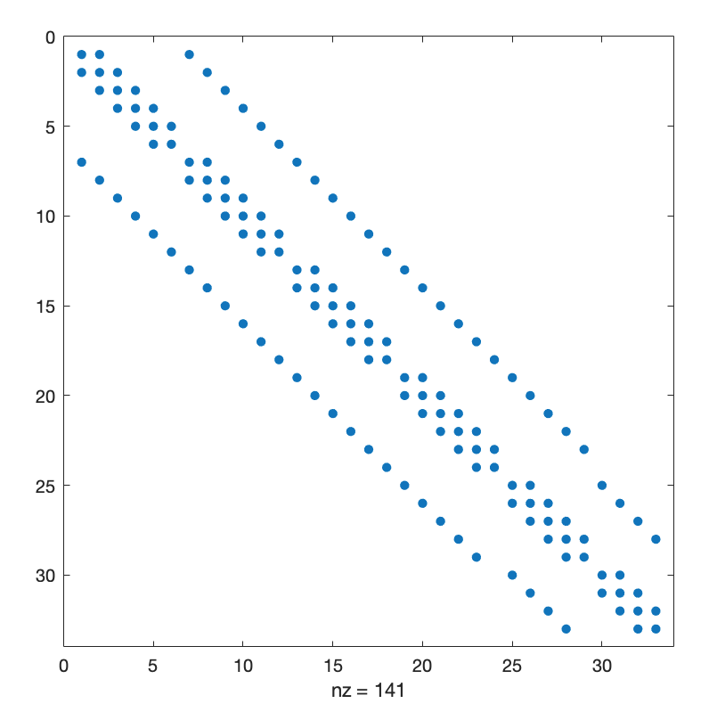
VISUALISATION OF MATRIX A AFTER DISCRETISATION

Slide 13
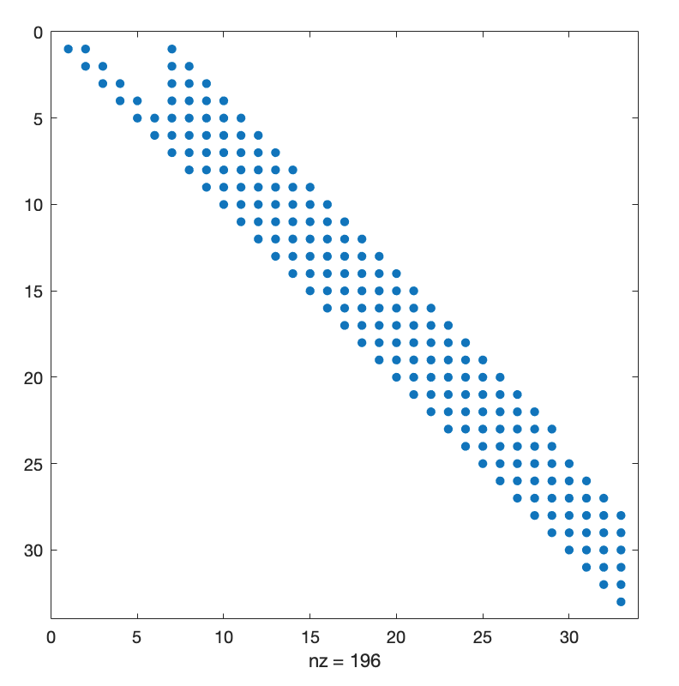
VISUALISATION OF MATRIX A AFTER CHOLESKY FACTORISATION

Slide 14
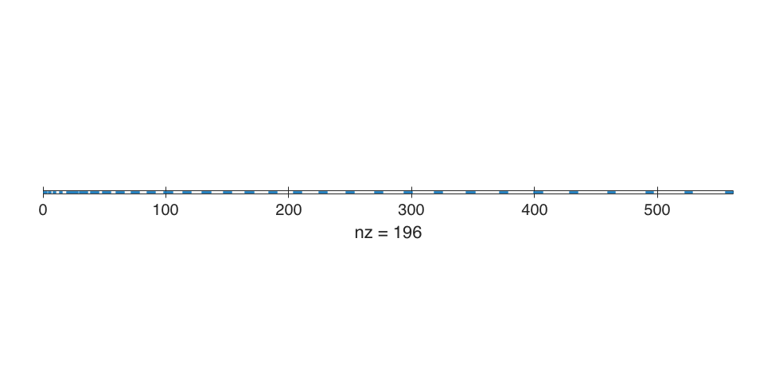
VISUALISATION OF MATRIX A USING PACKED STORAGE

Slide 15
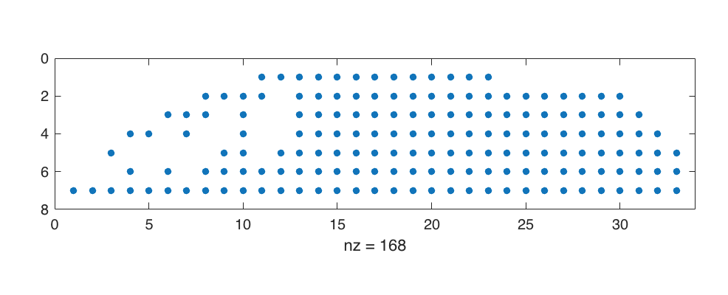
VISUALISATION OF MATRIX A USING BANDED STORAGE

Slide 16
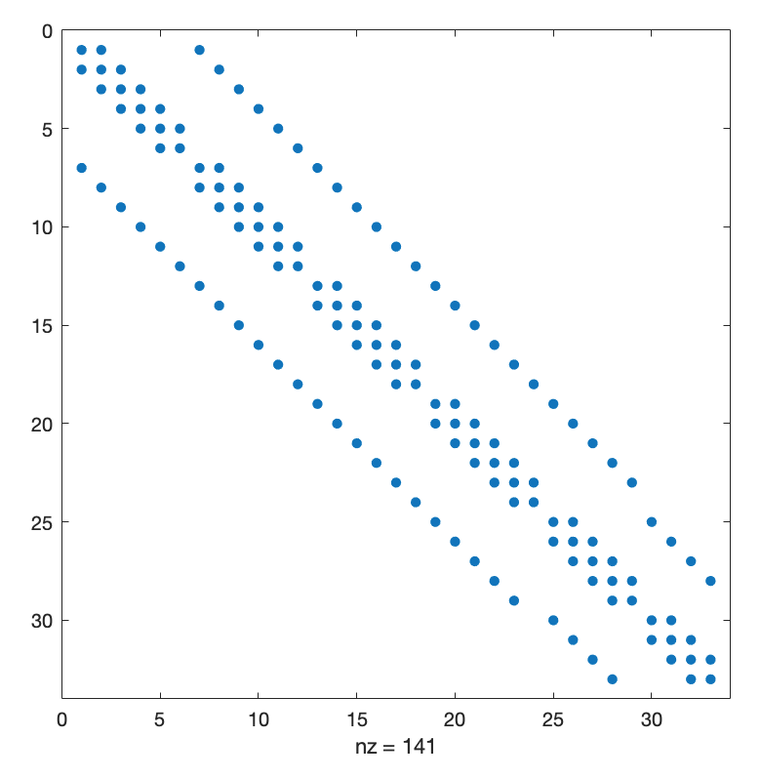
VISUALISATION OF MATRIX A USING SPARSE STORAGE

Slide 17
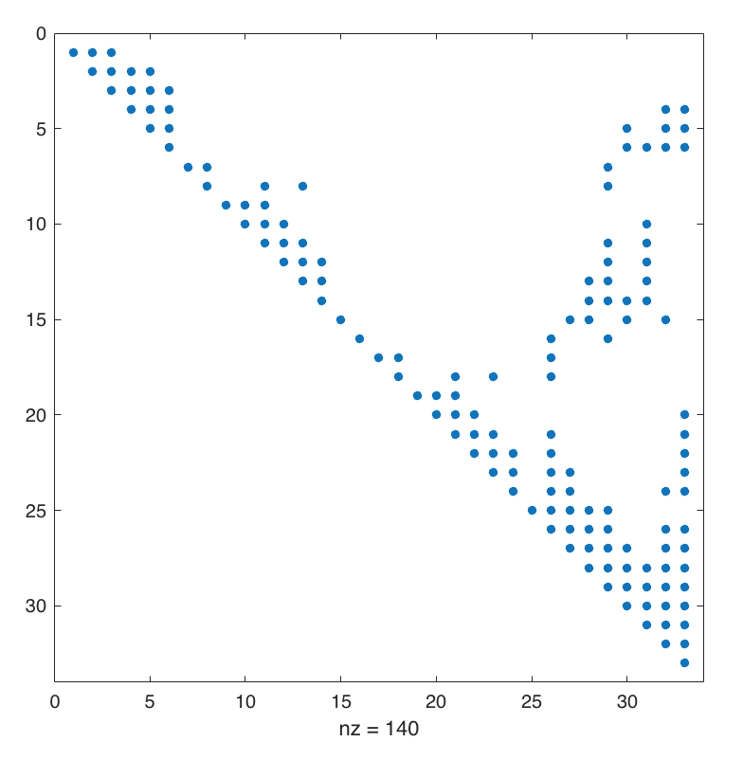
VISUALISATION OF MATRIX A USING SPARSE STORAGE

Slide 18
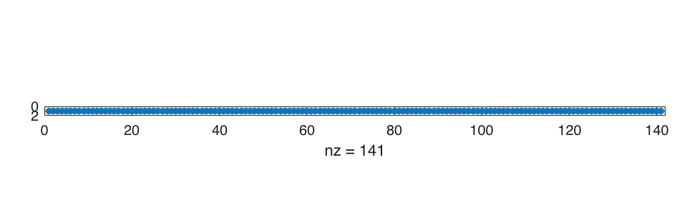
VISUALISATION OF MATRIX A USING CSR Storage

Slide 19
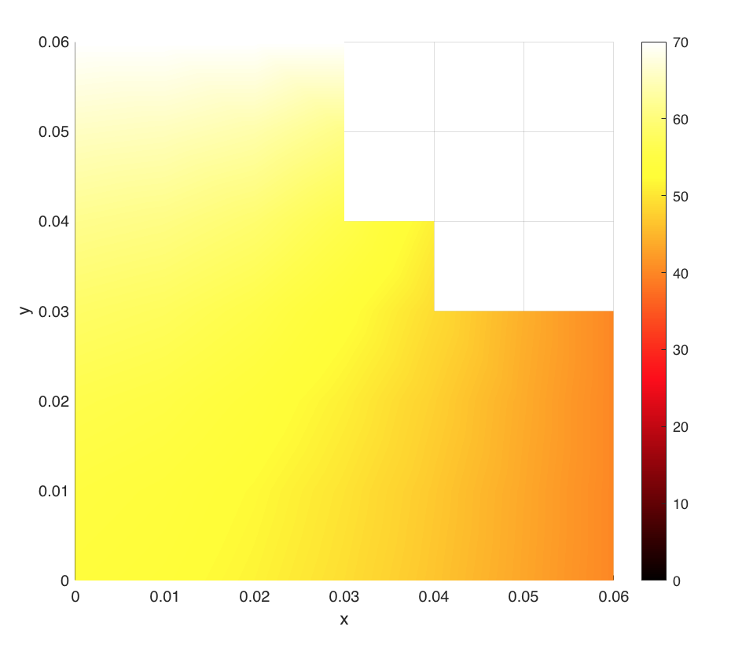
VISUALISATION of electronic component- intermediate steps

Slide 20
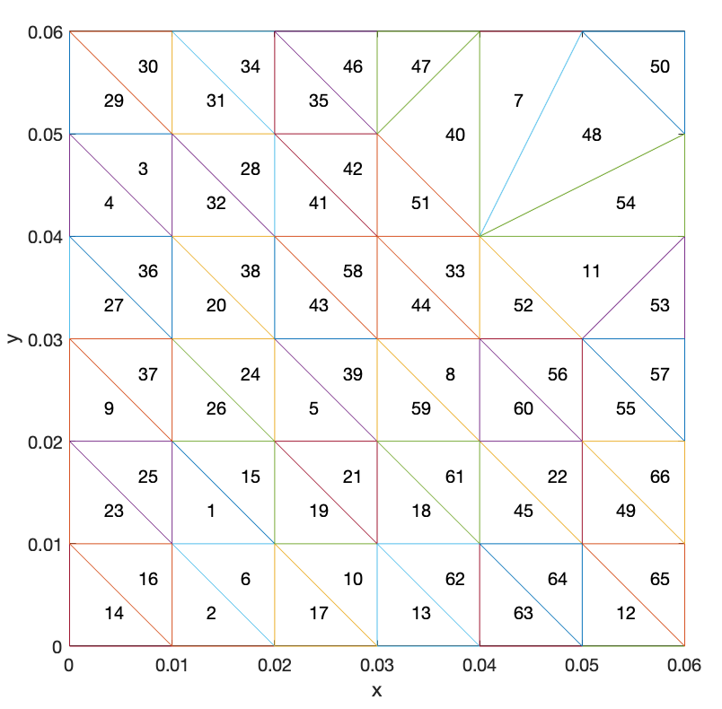
VISUALISATION of electronic component- intermediate steps

Slide 21
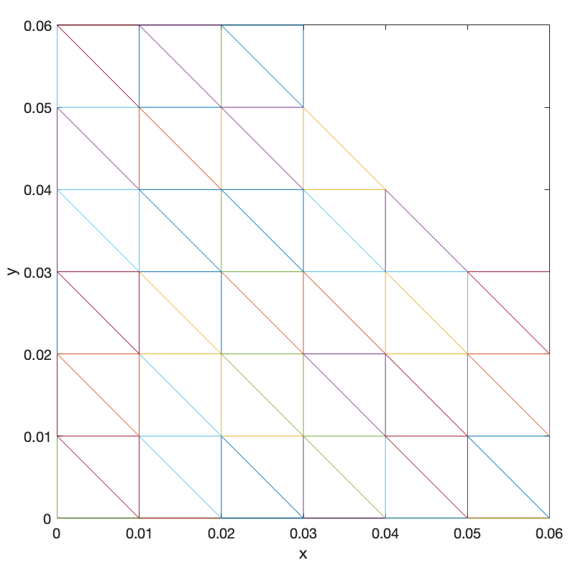
VISUALISATION of electronic component- intermediate steps

Slide 22
Visualisation of Heat Distribution in electronic component

